Slide 1
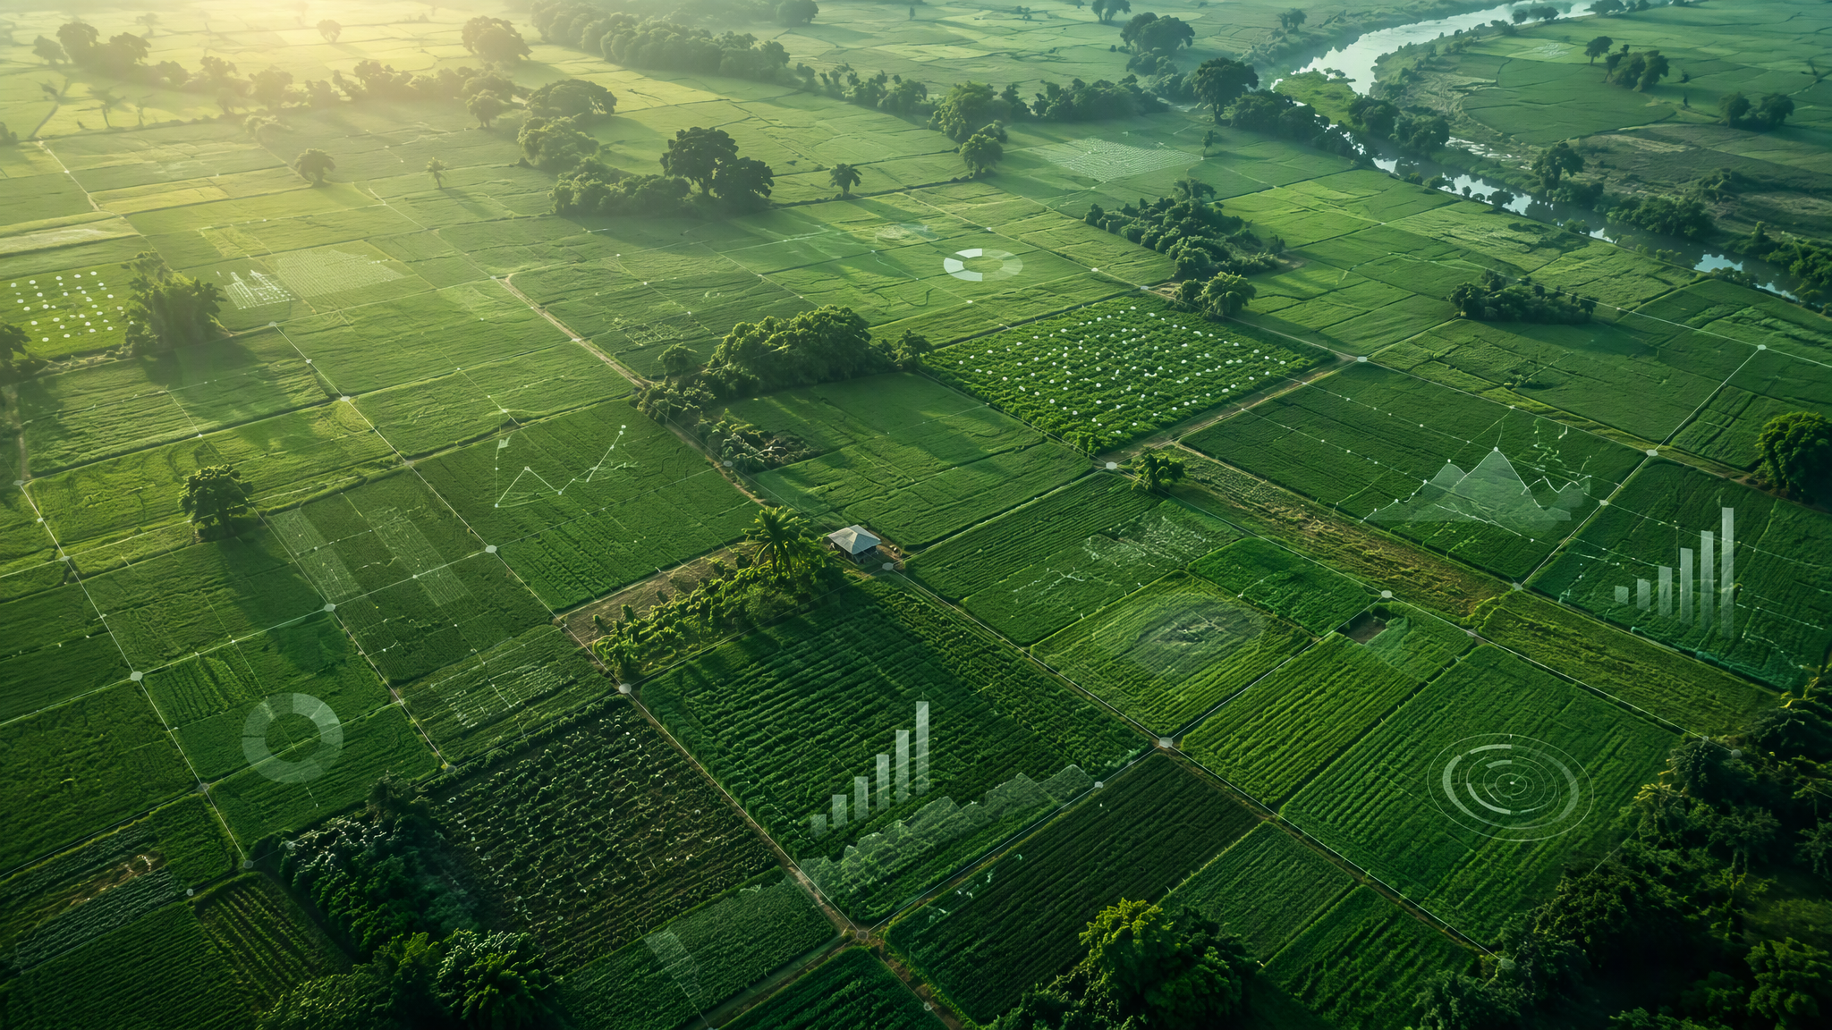
AGRICULTURAL DECISION SUPPORT · ANDROID · CSE PROJECT
AgriSense
Intelligent Crop Decision & Risk Analysis System
“Understand your farm. Plan your crop. Reduce uncertainty.”
TEAM
COLLEGE
DEPARTMENT
ACADEMIC YEAR
Taniya,Utkarsh,Tushya,Krish,
Jiya,Arnav
GNIOT, Group of Institution
Computer Science And Engineering
2026-27

Slide 2
THE PROBLEM
The farmer's decision is more complicated than choosing a crop
FARM & FIELD
CLIMATE & CROP
MARKET & COST
Choosing a crop means weighing field conditions, climate, biology and economics at the same time — eleven factors shape the outcome.
Soil condition
Weather
Market price
Water availability
Expected yield
Price volatility
Previous crop
Disease & pest risk
Cultivation cost
Long-term farm conditions
Crop duration
“A crop that looks profitable on paper may not be the best crop for a particular farm.”
One decision — which crop, this farm, this season?
02 / 14

Slide 3
THE IDEA
Meet AgriSense
A farm-level decision-support app that evaluates crop options against farm conditions, environmental factors and economics — together, not in isolation.
Farm data
Crop recommendations
Soil
AgriSense
Expected profit & ROI
Weather
DECISION ENGINE
Water
Suitability scoring · economics
risk analysis · scenarios
Risk levels
Crop information
What-if scenarios
Market & economic data
Working prototype — combines farmer input with demonstration datasets and modeled estimates.
03 / 14

Slide 4
WHY AGRISENSE
Not Just “What Should I Plant?”
SIMPLE RECOMMENDER
AGRISENSE
Soil looks suitable
Plant Crop X
Crop X fits your soil — but what is the expected profit, the water requirement, the risk, the crop duration — and how does it behave in downside scenarios?
One variable in, one answer out.
No economics, no uncertainty, no downside.
CORE CAPABILITIES
Crop suitability
Profit estimation
ROI
Risk analysis
Water requirement
Crop comparison
What-if simulation
Long-term planning
The app helps the farmer understand the decision — not blindly follow one recommendation.
04 / 14

Slide 5
SYSTEM
From Farm Data to a Crop Decision
INPUTS
OUTPUT
Soil data
DECISION CORE
Recommendation engine
Weather data
Estimation
yield · revenue · profit
Water availability
Farmer Decision Report
Risk analysis
ranked recommendations
economics · risk
scenario comparison
Crop database
What-if simulation
Market & cost data
Every stage runs on-device in the current prototype; data sources are demo datasets.
05 / 14

Slide 6
APP WORKFLOW
Inside the AgriSense App
Twelve screens, one continuous decision journey — from farm setup to a shareable report.
1
2
3
4
5
6
Onboarding
Farm Setup
Farm Dashboard
Soil Analysis
Weather
Crop Recommendations
12
11
10
9
8
7
Farm Report
Long-Term Plan
Scenario Analysis
What-If
Crop Comparison
Crop Details
Each screen answers one question in the decision flow — no dead ends, no orphaned features.
06 / 14

Slide 7
UI SHOWCASE
AgriSense — Mobile Experience
AgriSense
AgriSense
AgriSense
AgriSense
Dashboard
Soil Analysis
Crop Recommendations
What-If Simulator
Placeholder frames — app screenshots drop in at the same size, undistorted.
07 / 14

Slide 8
CROP RECOMMENDATION
More Than a Single Recommendation
PROTOTYPE · DEMO ESTIMATES
CROP
SUITABILITY / 100
EXPECTED PROFIT (₹ / SEASON)
RISK
CONFIDENCE
Maize
87
Medium
76%
95–110 days
Water: medium
₹43K – ₹68K
Mustard
82
Low–Med
81%
110–140 days
Water: low
₹38K – ₹61K
Chickpea
78
Low
72%
100–120 days
Water: low
₹34K – ₹57K
Rice
61
High
65%
130–150 days
Water: high
₹30K – ₹64K
Modeled estimates from the prototype's demo dataset — illustrative comparison, not a live prediction.
08 / 14

Slide 9
THE STAR FEATURE
What If?
ADJUST THE CONDITIONS
MODELED SCENARIO OUTPUTS
Normal conditions
₹55K expected profit
Rainfall
Risk: medium
Temperature
30% lower rainfall
₹28K expected profit
Market price
Risk: high
Fertilizer cost
Higher market price
₹71K expected profit
Water availability
Risk: medium
Scenario outputs are modeled demo values.
The farmer can explore how a decision behaves when conditions change — before committing seed, money and time.
09 / 14

Slide 10
ECONOMICS
From Yield to Profit
Expected revenue = expected yield × expected price
Expected profit = expected revenue − cultivation cost
₹82–104K
ALSO COMPUTED PER CROP
ROI
Return on cultivation cost
₹43–68K
Crop duration
Days from sowing to harvest
−
=
₹32–39K
Profit per day
Profit normalised by crop duration
Market risk
Price volatility expected at harvest
Expected revenue
Estimated cost
Expected profit
Demo estimates from the prototype's sample crop dataset.
conservative bound
optimistic range
10 / 14

Slide 11
RISK & LONG-TERM THINKING
Profit Is Not the Only Objective
SIX RISK DIMENSIONS, SCORED PER CROP
LONG-TERM CROP PLANNING
Weather risk
Rainfall and temperature swings during the season
YEAR 1
YEAR 2
YEAR 3
Maize
Chickpea
Mustard
Water risk
Irrigation availability vs. crop water requirement
Market risk
Rotation-aware: legumes restore soil nitrogen after cereal seasons.
Price volatility between sowing and harvest
The system evaluates short-term economics while also weighing multi-year crop planning and rotation.
This year's profit should not become next year's problem — soil health and risk compound across seasons.
Disease risk
Pest and disease pressure for the region and season
Soil risk
Nutrient depletion and degradation across seasons
Cost risk
Input price inflation — seed, fertilizer, labour
11 / 14

Slide 12
ARCHITECTURE
Technology Behind AgriSense
FRONTEND
PLANNED INTEGRATIONS
Android application
future scope — not yet implemented
Kotlin · Jetpack Compose
Weather APIs
Soil-test data
APPLICATION LAYER
Market / mandi data
ML yield prediction
UI
ViewModel & state
Recommendation engine
Scenario engine
ML price prediction
ESP32 / IoT sensors
Bluetooth
GPS
DATA LAYER
FastAPI
PostgreSQL
Local demo data
Crop database
Farm data
implemented in prototype
planned / future integration
The prototype runs fully on-device with local demo data; live sources connect through a FastAPI + PostgreSQL backend as they are added.
12 / 14

Slide 13
LIMITATIONS & FUTURE SCOPE
Where AgriSense Goes Next
CURRENT LIMITATIONS — PROTOTYPE
DEVELOPMENT ROADMAP
Some modules run on demonstration / local data
1
2
3
4
Real agricultural predictions require validated regional datasets
Real weather API
Real market / mandi data
Soil-test integration
ML yield prediction
Market and weather features need live API integration
8
7
6
5
ML models require sufficient historical regional data
Scale & personalized recommendations
Hindi / local voice interface
ESP32 IoT field sensors
Price & risk prediction
Sensor measurements require calibrated hardware
Recommendations are decision support — not guaranteed outcomes
Each phase is independent — the app stays useful at every stage of the roadmap, and each addition strengthens the decision engine.
13 / 14

Slide 14
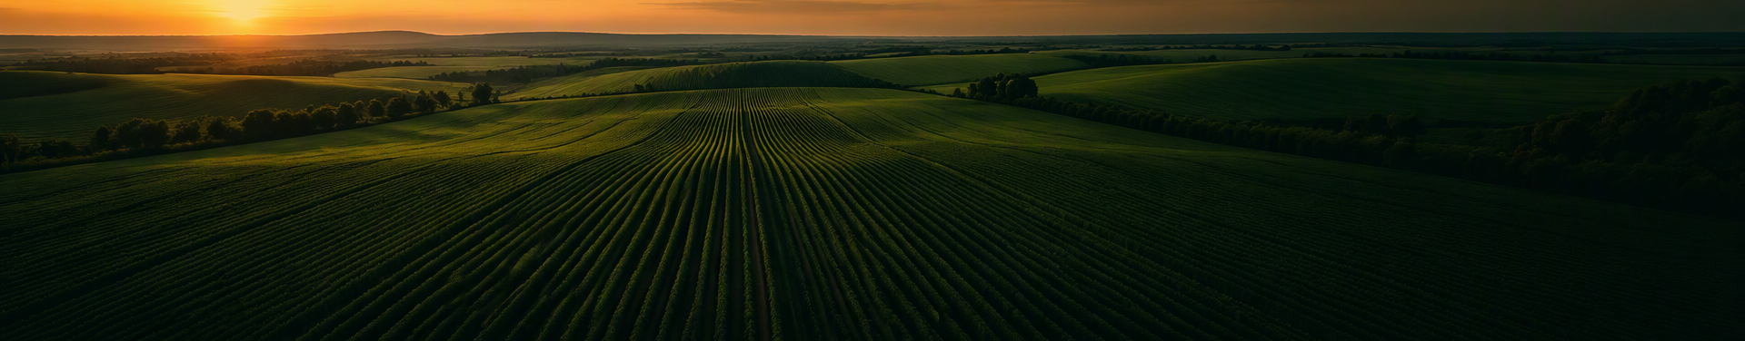
CONCLUSION
AgriSense — Smarter Decisions, Not Blind Predictions
Soil
+
Weather
+
Water
+
Economics
+
Crop knowledge
+
Risk
+
Scenario analysis
→better-informed planting decisions, compared before sowing
“The goal is not to tell farmers what to do.
The goal is to help them make better-informed decisions.”
Thank You
Questions?
14 / 14

